Slide 1


Slide 2
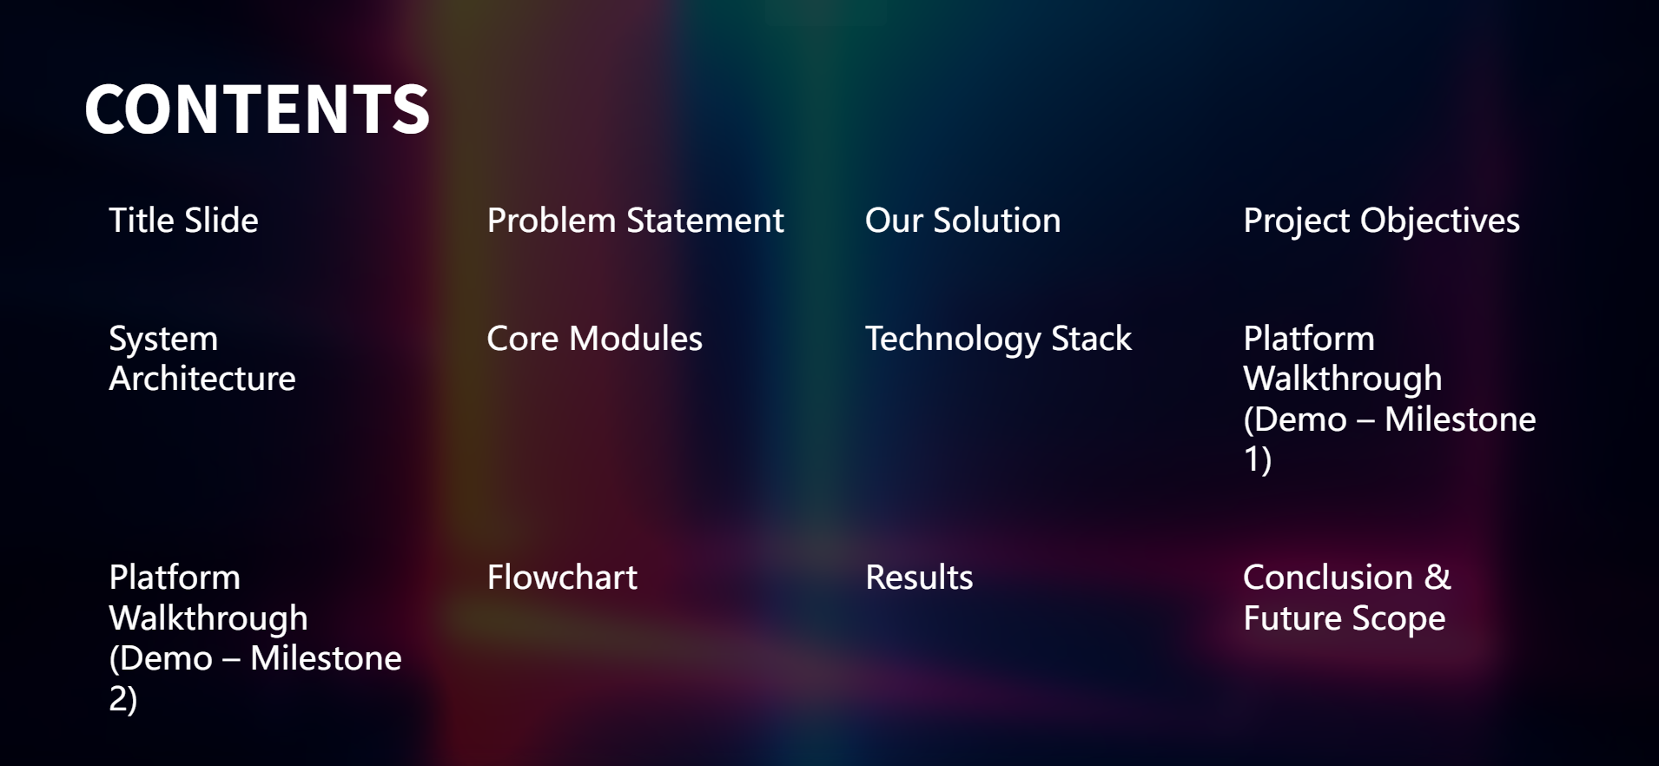
2 and 3 AND 4)
2 and 3

Slide 3
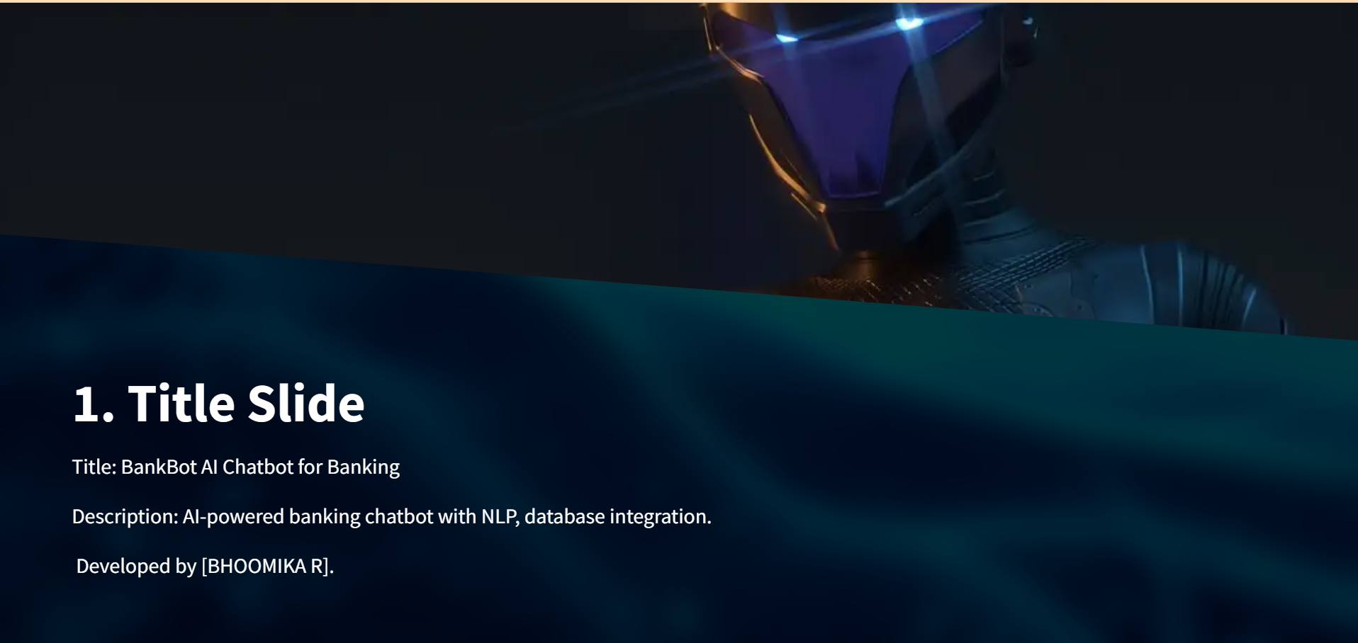

Slide 4
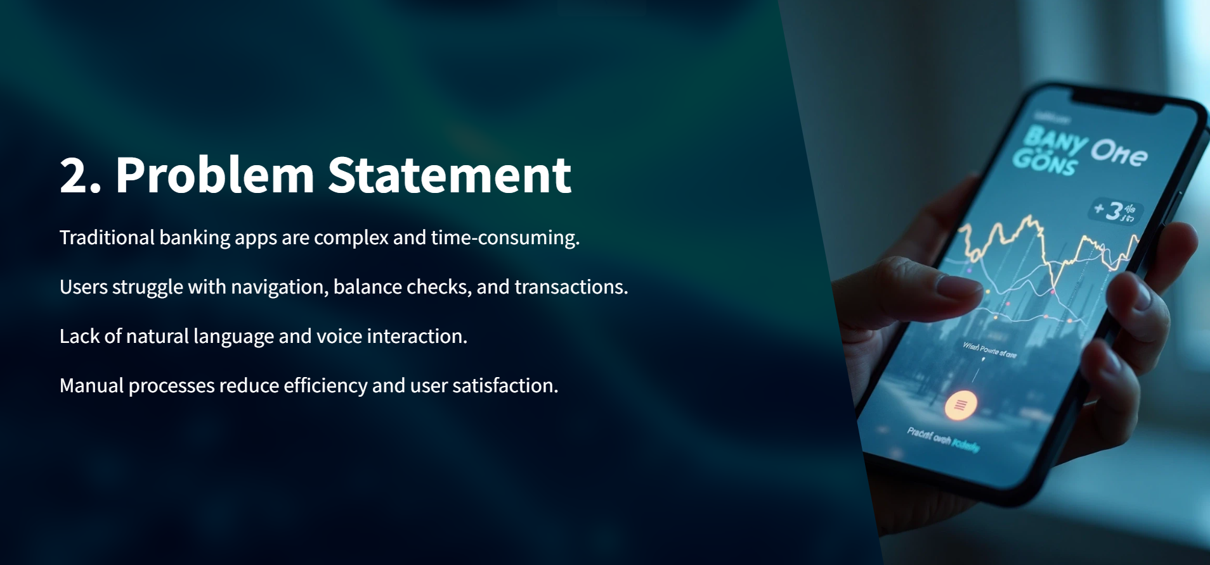

Slide 5
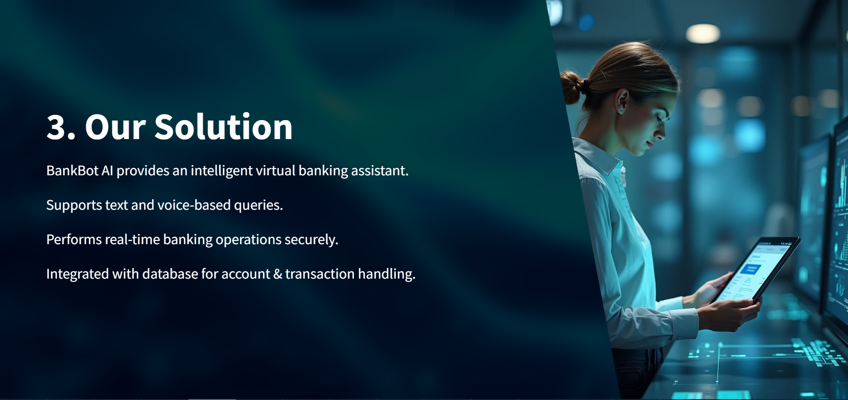

AI-powered hybrid portal that combines Structured Data (SQLite for money) with Unstructured Intelligence (Groq LLM for knowledge).

Slide 6
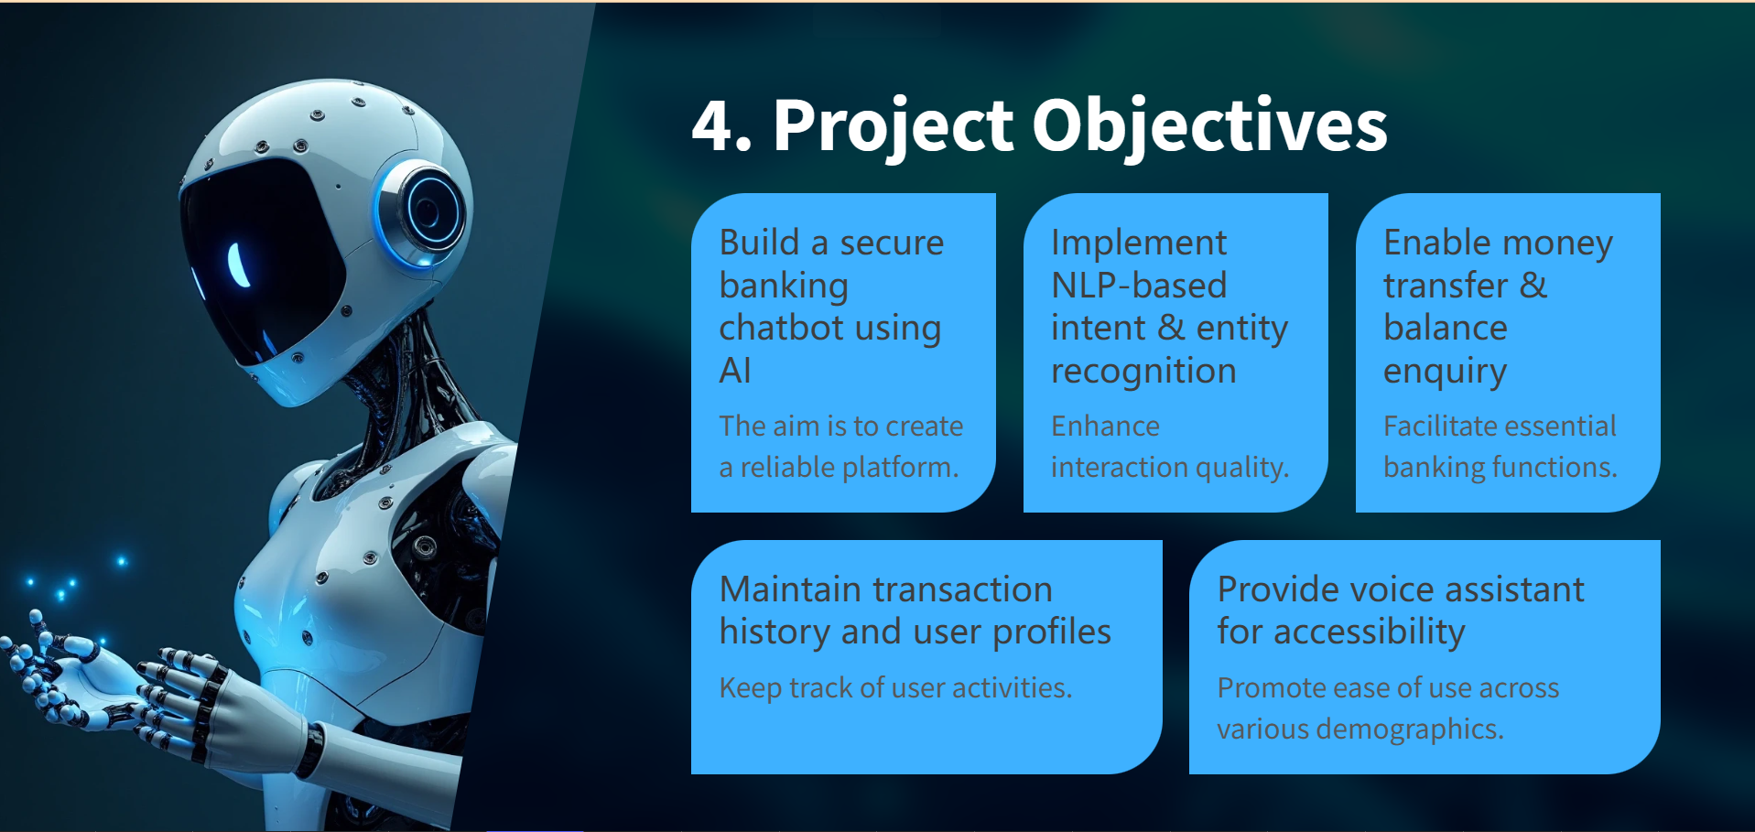
text

Slide 7
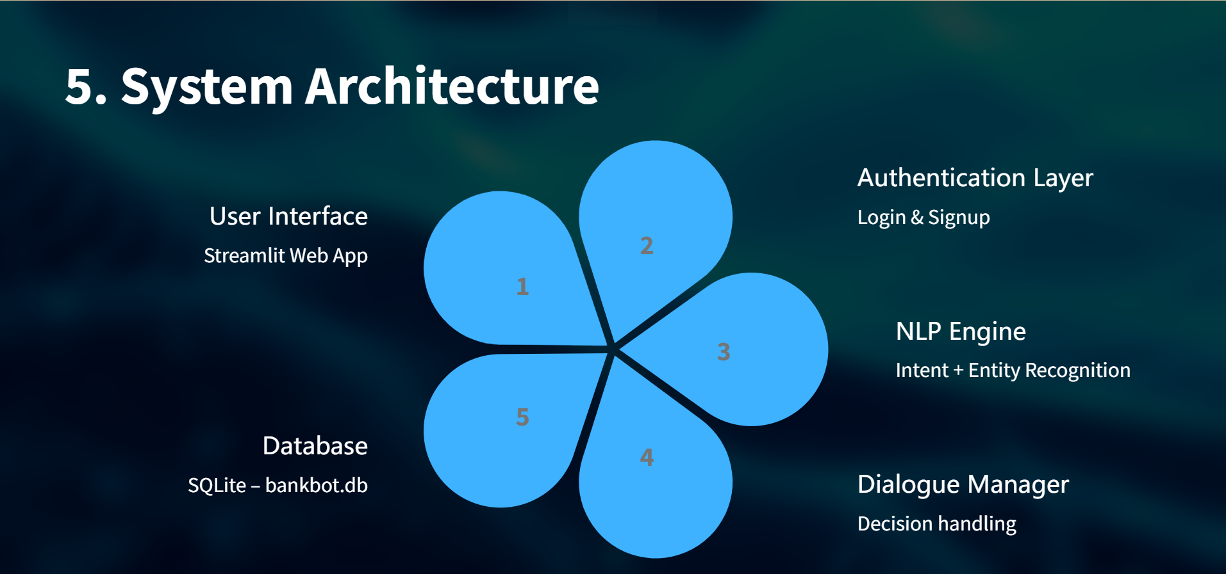
Hybrid engine: Groq for cloud speed, Local for offline privacy.

Slide 8
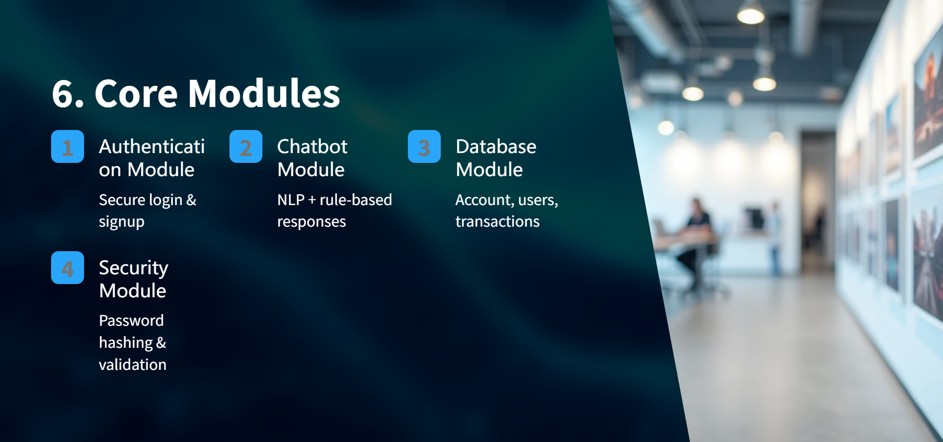
5
Cloud: Groq Llama-3.1-8B (Speed) | Local: Meta-Llama-3.1-8B-GGUF (Privacy/Offline).

Slide 9
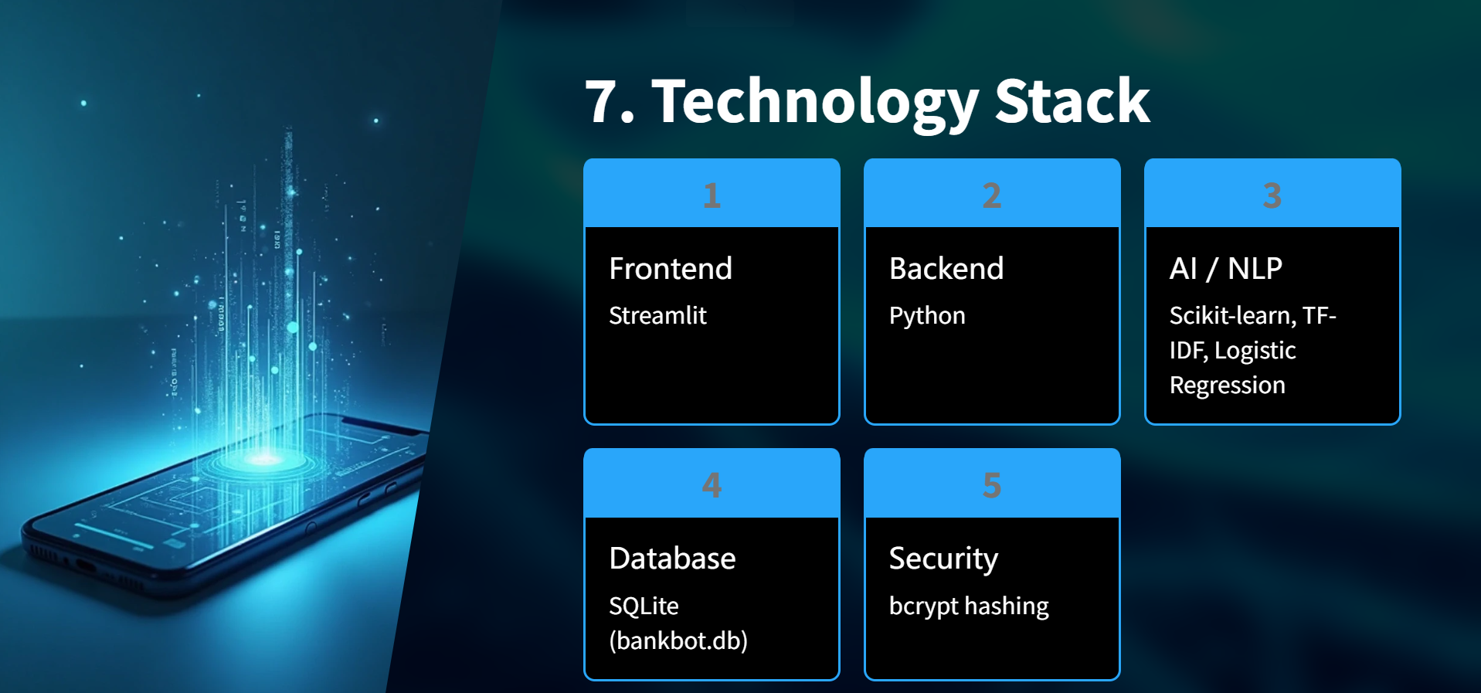
+ css
+ Groq & Local Llama

Slide 10
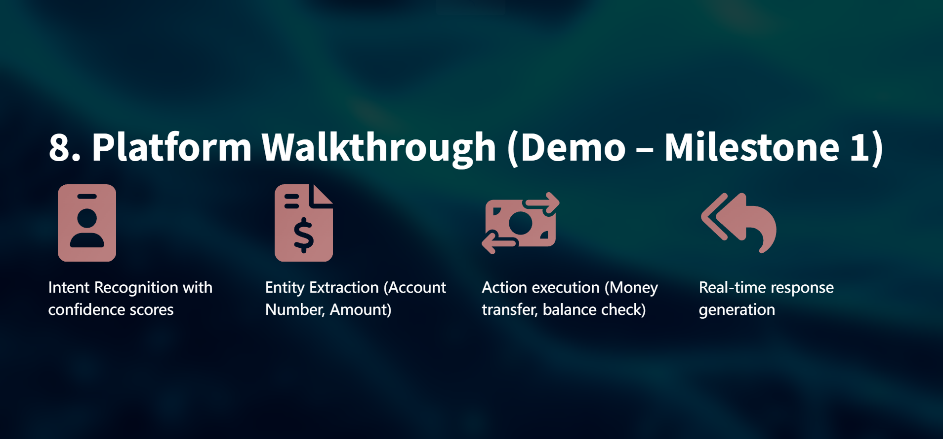

Slide 11
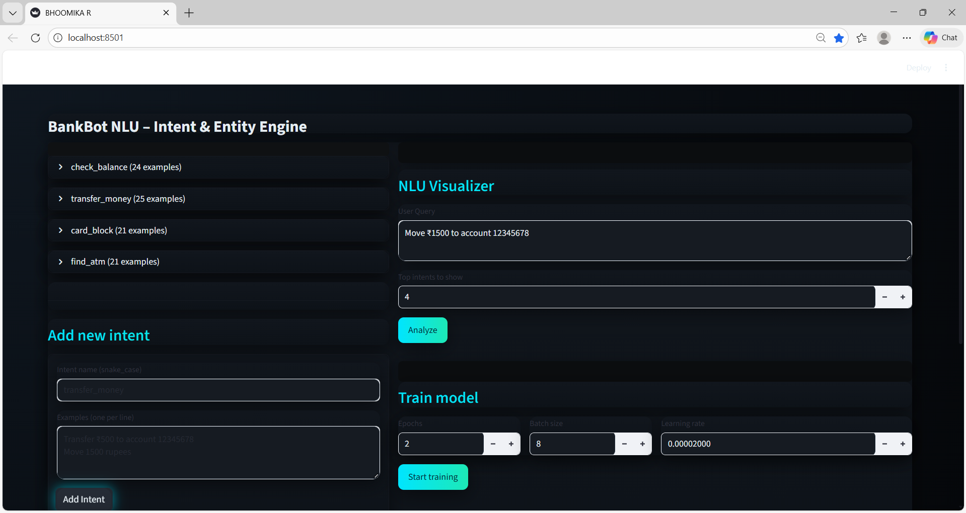
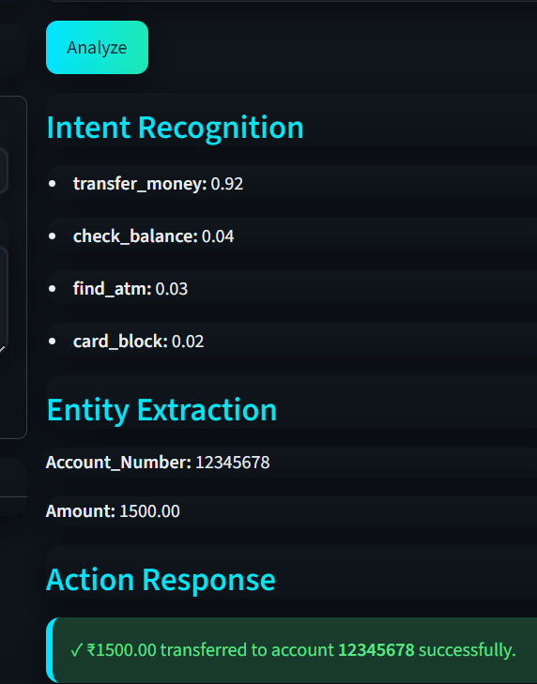
Milestone 1 ;-

Slide 12
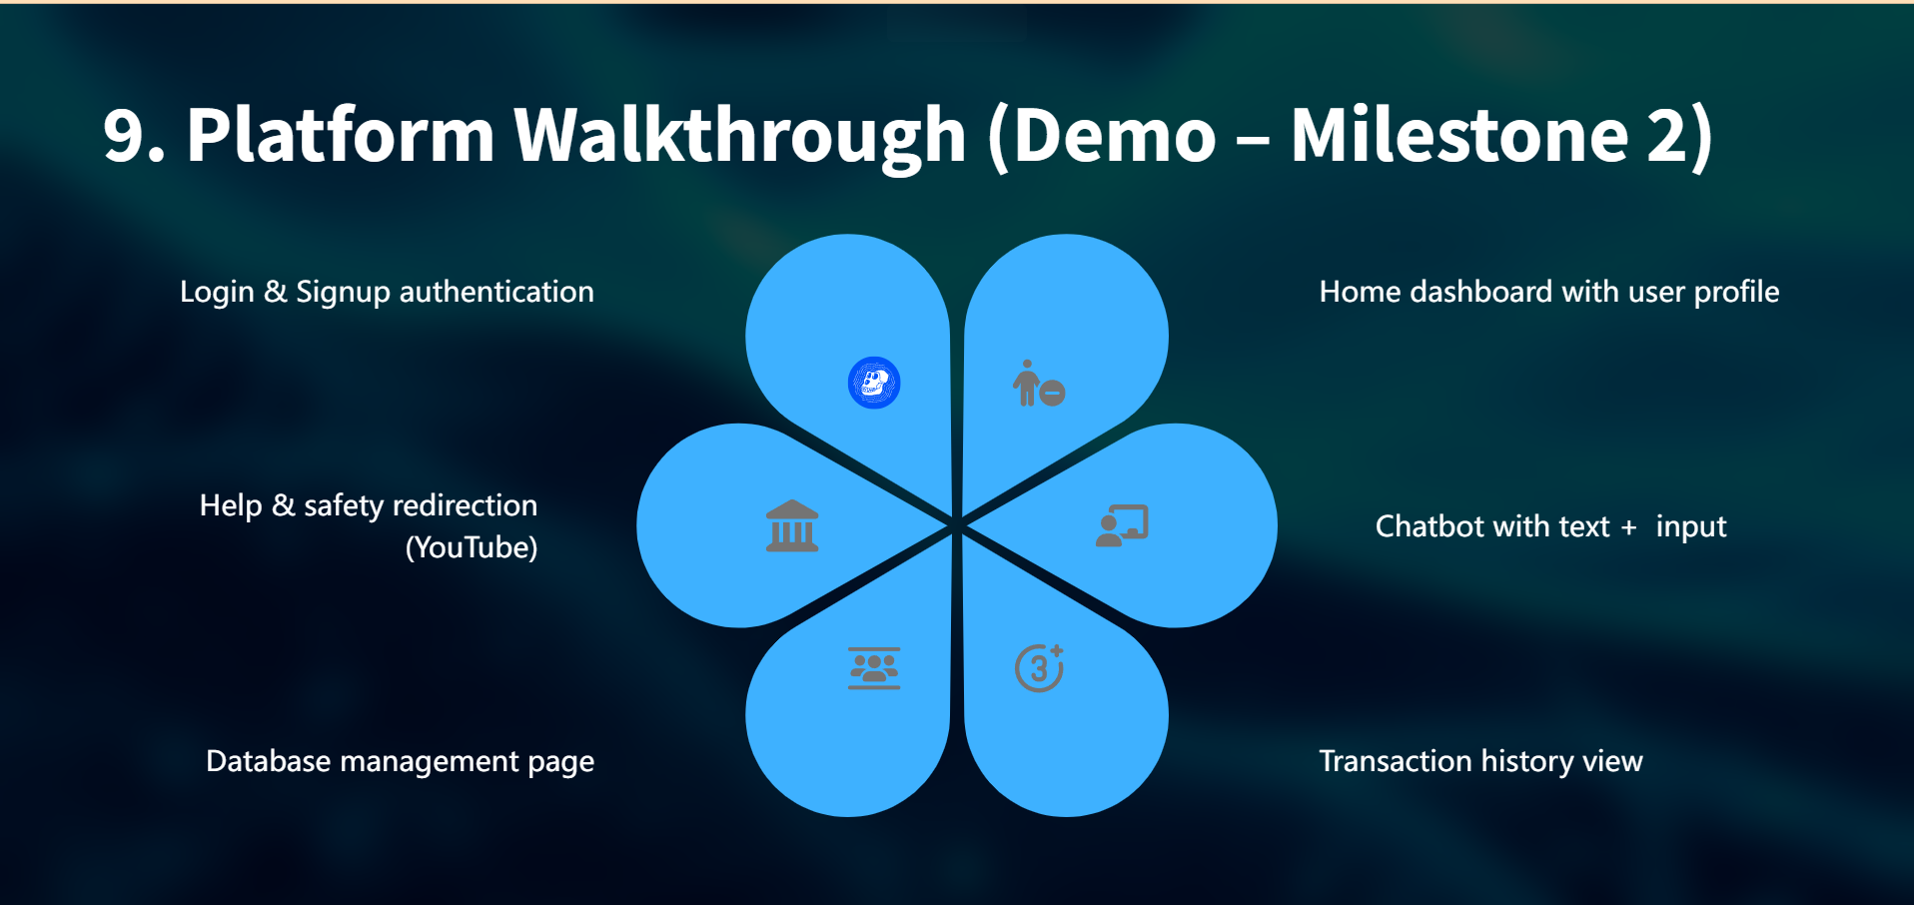

Slide 13
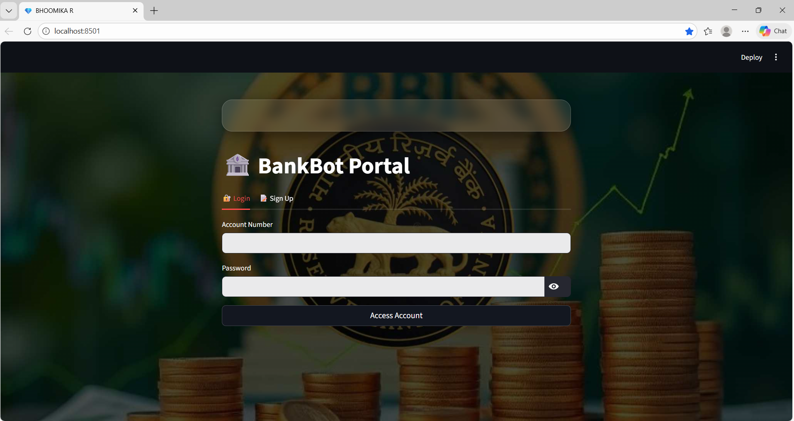
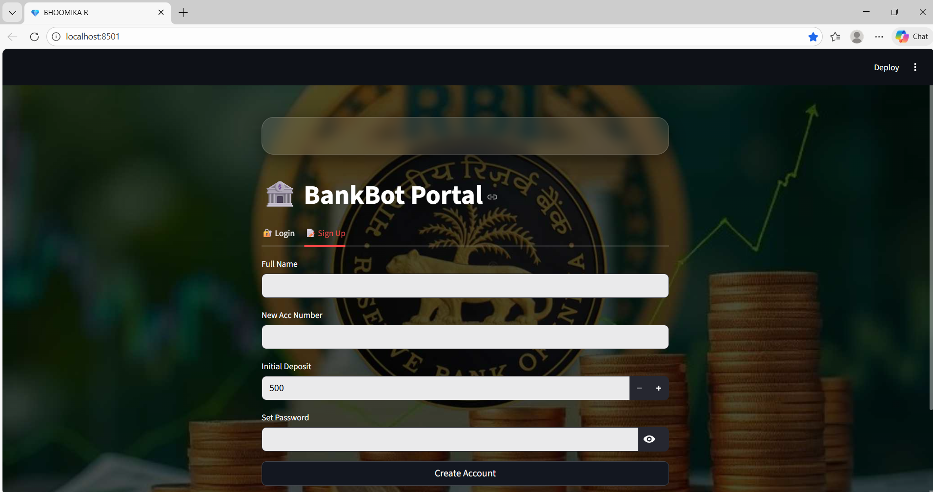
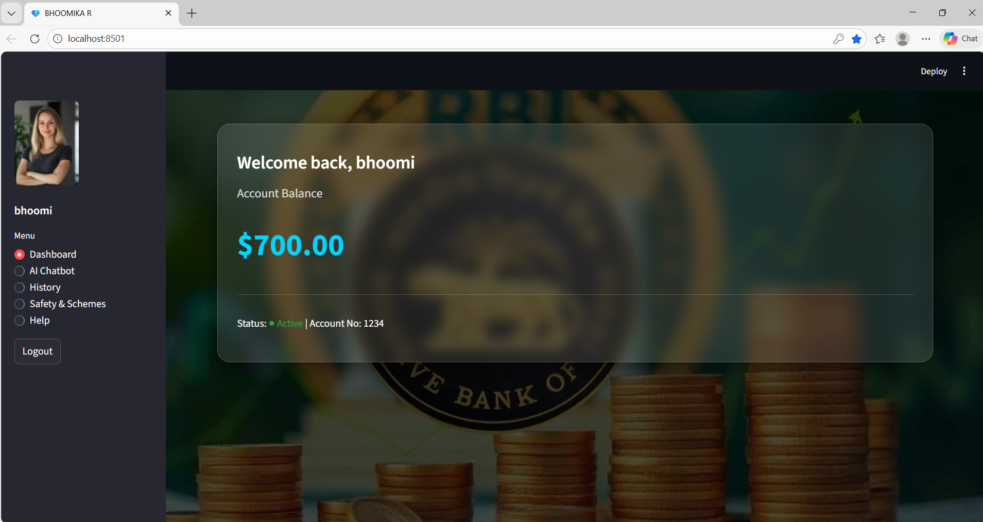
Milestone 2;-

Slide 14
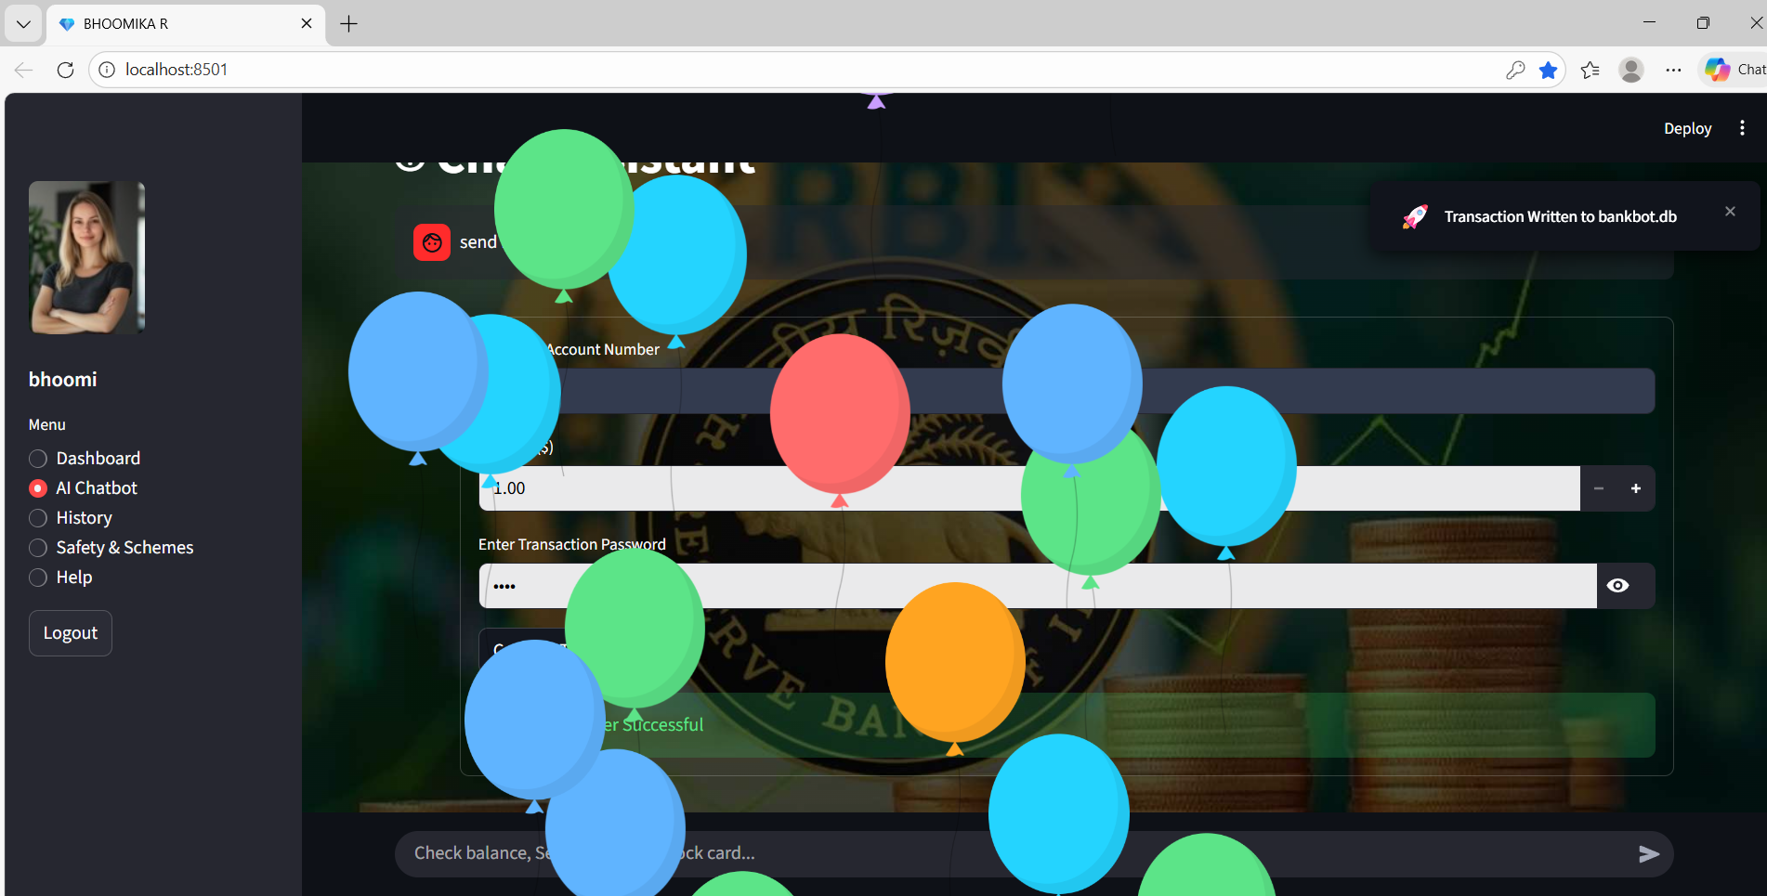
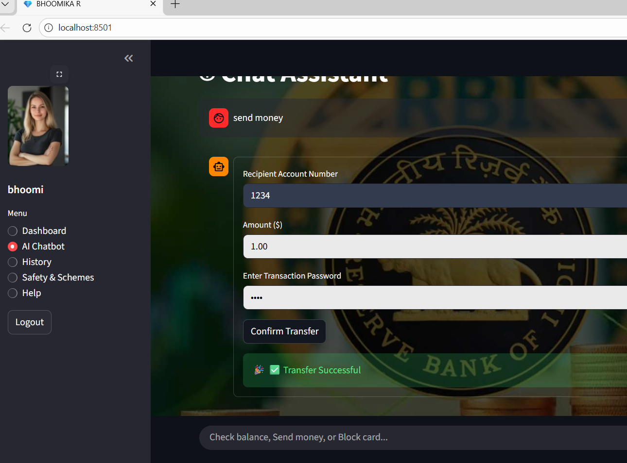

Slide 15
Platform Walkthrough (Demo –Milestone3)
Uses types/interacts
Dialogue Routing
Money/user data
General quries(Groq cloud/local LLM)

Slide 16
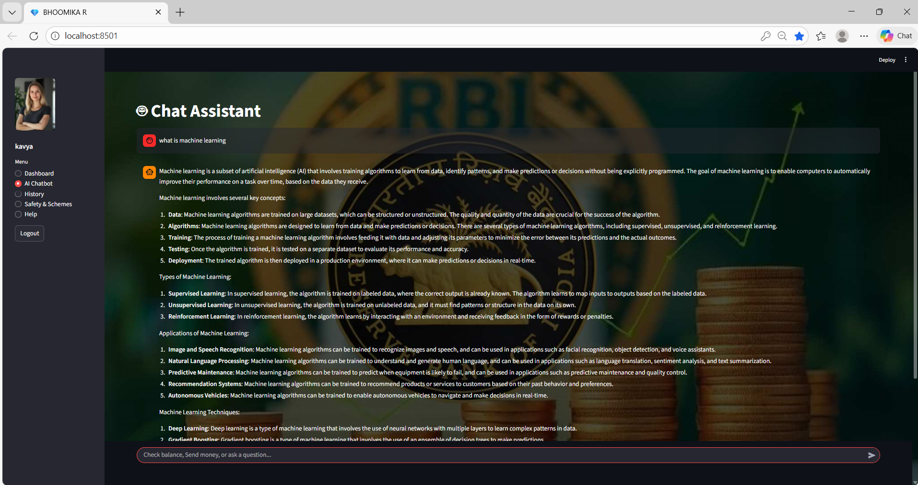
Milestone 3 :-

Slide 17
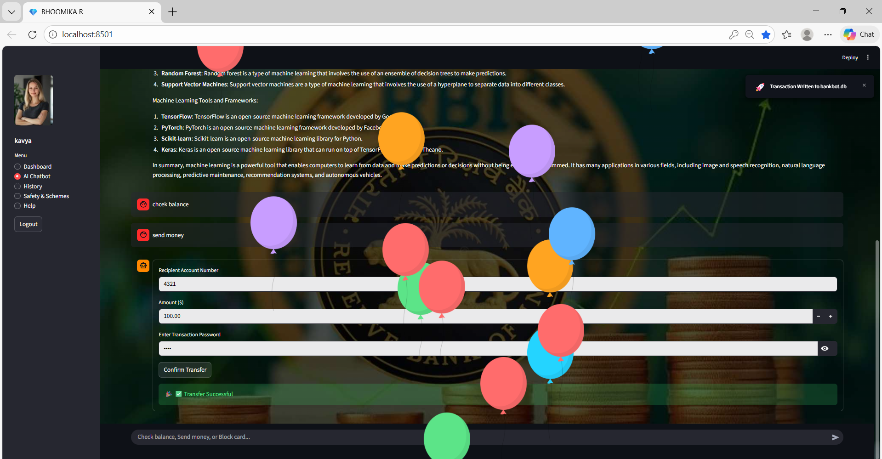

Slide 18
Platform Walkthrough (Demo –Milestone4)
Intent Manager
Model Trainer
Logic Router
Audit Exports
graph Analytics

Slide 19
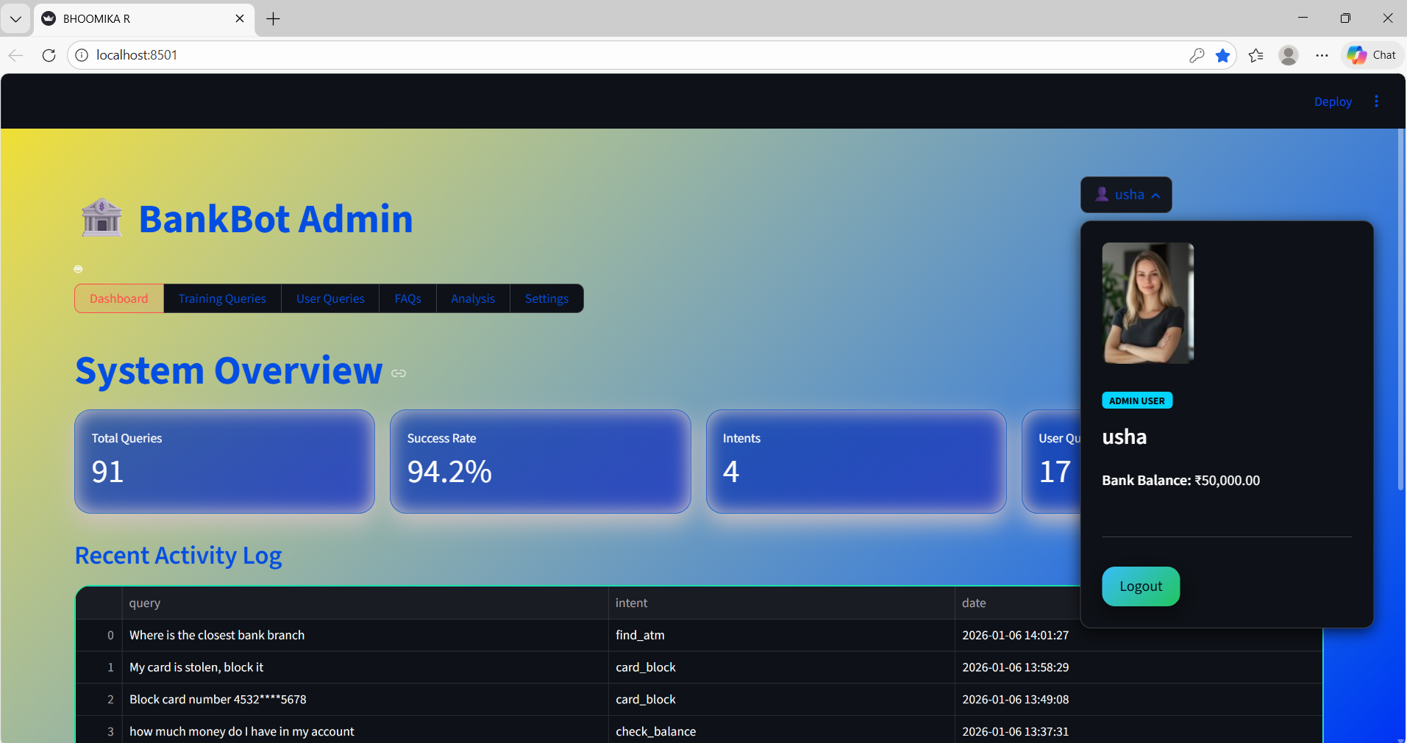
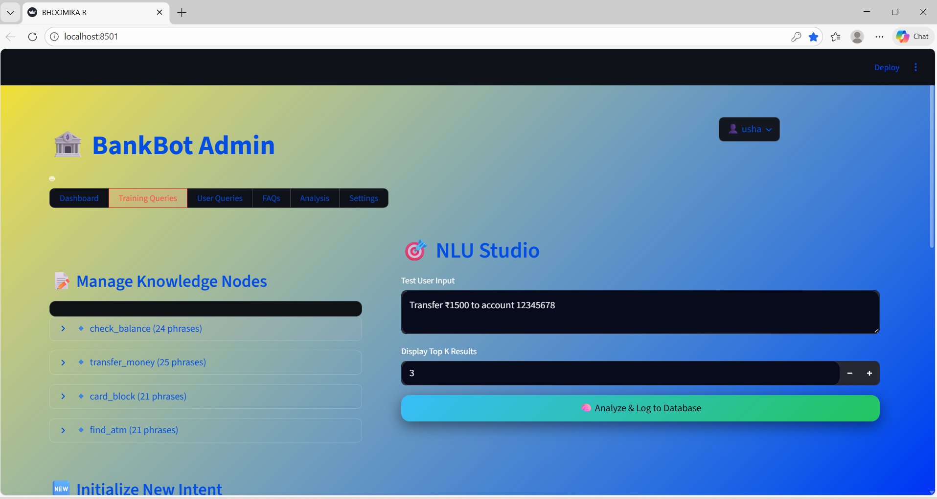
Milestone 4 :-

Slide 20
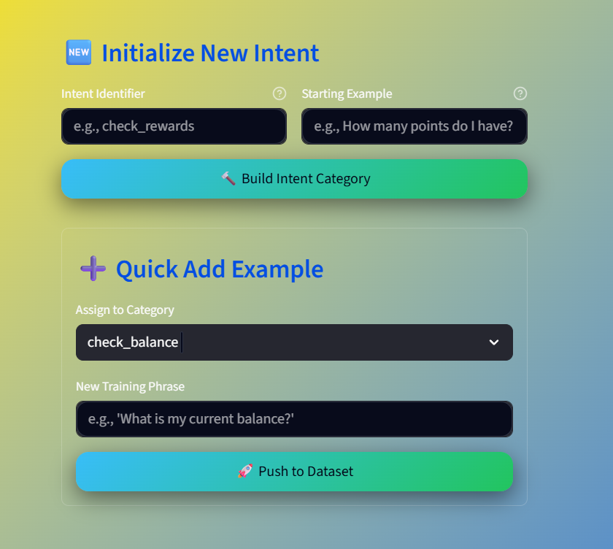
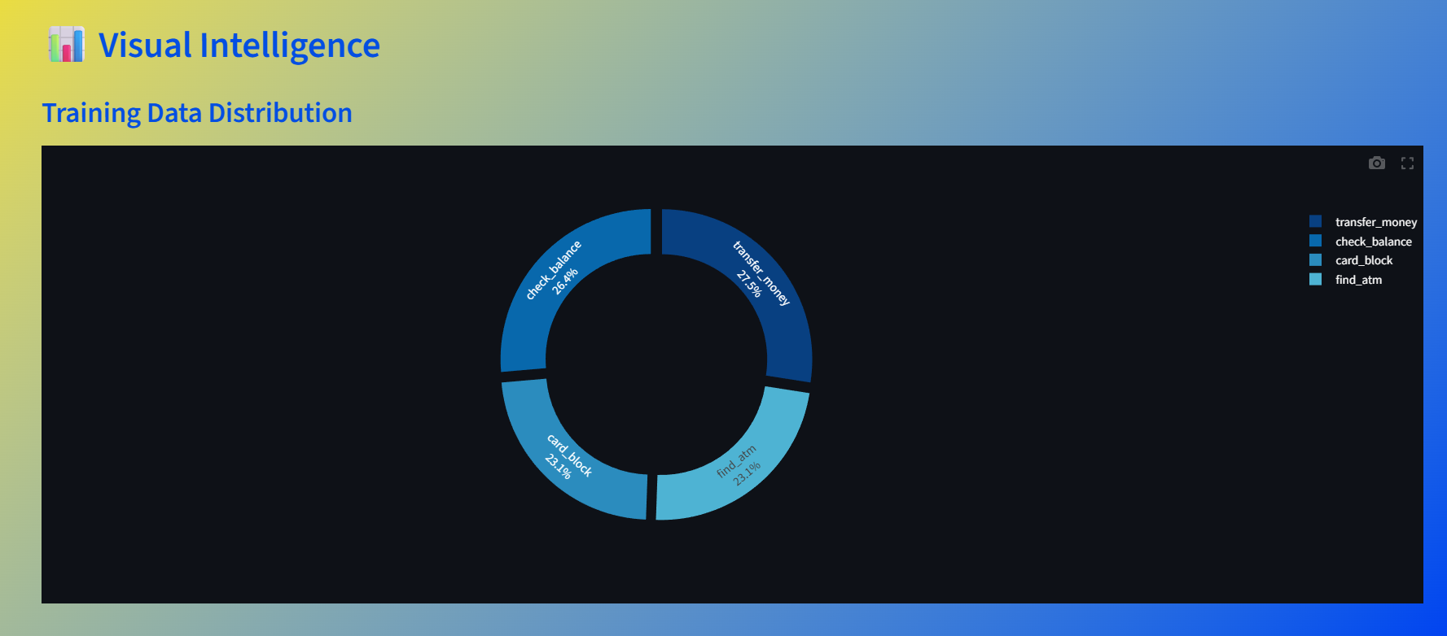

Slide 21
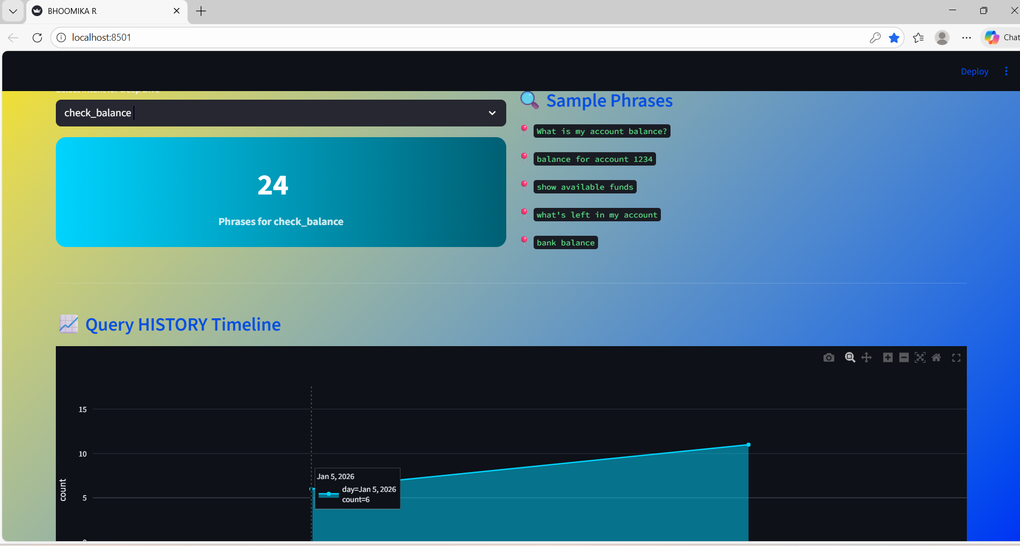

Slide 22
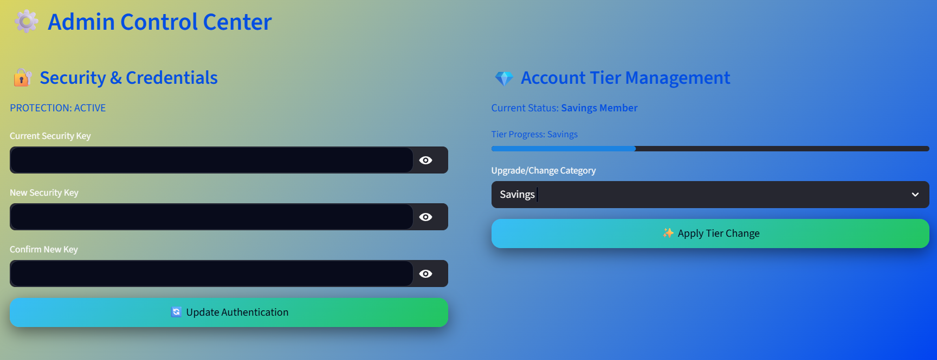

Slide 23
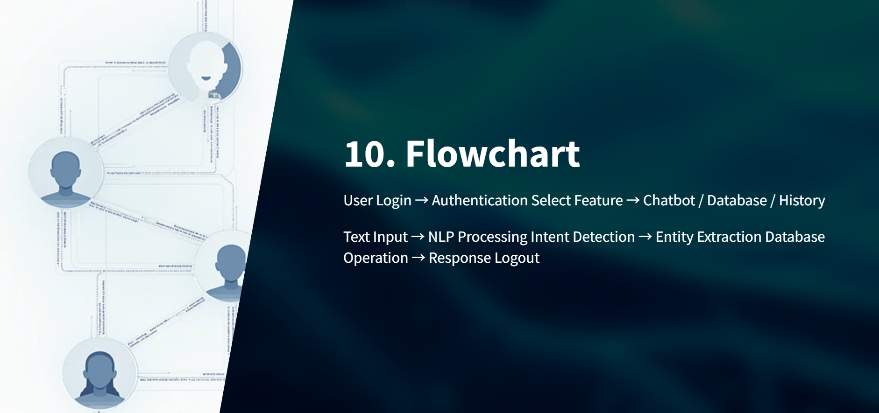
/Reasoning Layer(Groq Cloud / Llama 3.1)

Slide 24
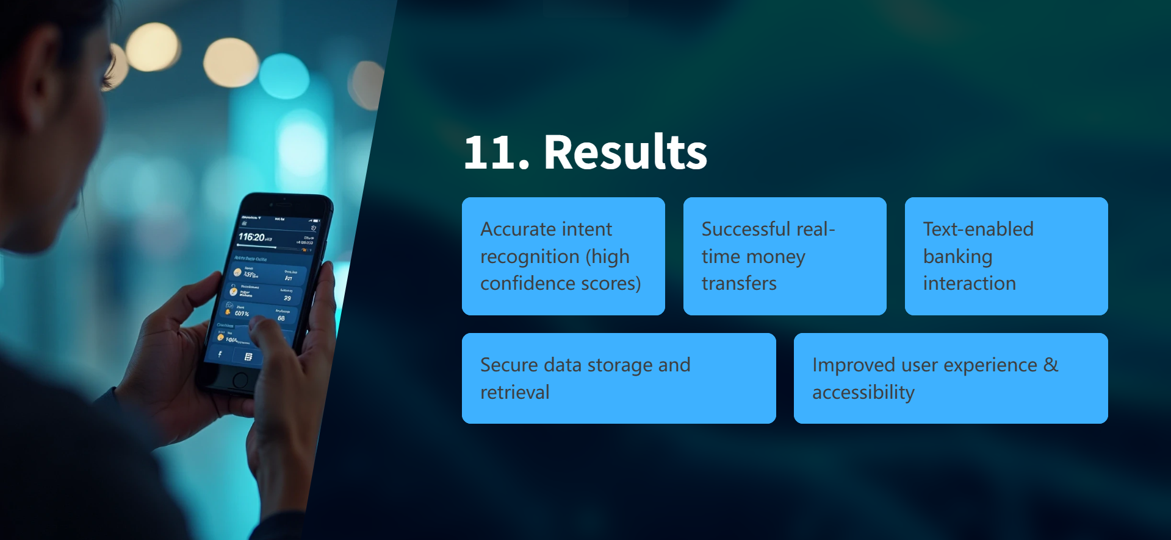

Slide 25
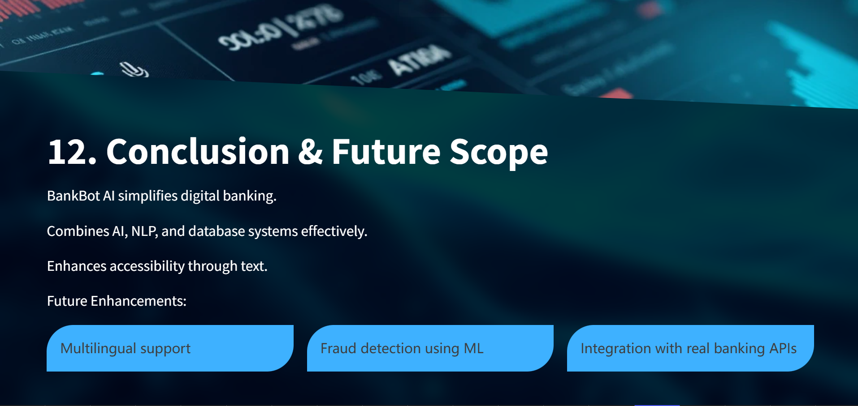

Slide 26


